Slide 1


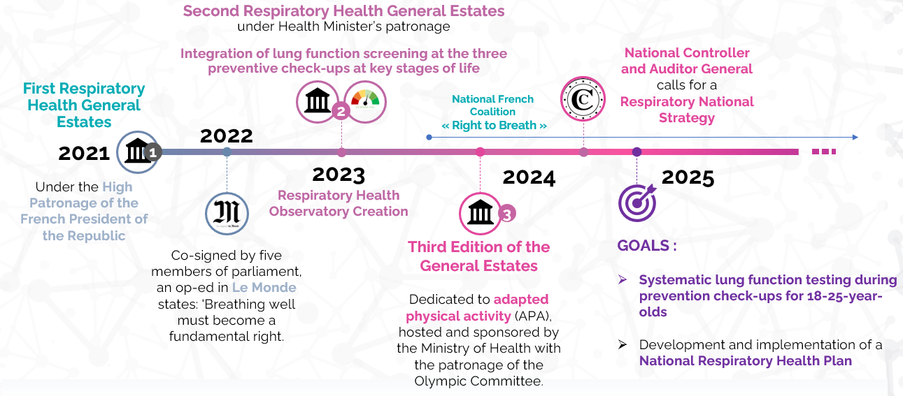
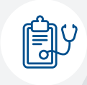

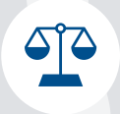
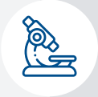
Collectif Droit à Respirer France
In 2024, the coalition received a €50K grant to develop the National Respiratory Health Plan.
Key progress: taskforce formed, draft plan underway, institutional consultation launched, awaiting publication of opinion article, national symposium planned.
In France,
10 million people suffer from respiratory diseases,
causing 144,600 deaths annually.
Asthma affects 4.2 million,
COPD 3.5 million,
and lung cancer
160 000 people nationwide.
Key milestones: National Respiratory Health Plan, annual Respiratory Health Conference, and 2026 National Cause.
Progress measured by ministerial support, institutional meetings, and uptake in the French social security finance bill.
Notes:
Mettre à jour la diapo timeline
Proposer qu’elle prenne toute la place (gauche, droite) pour meilleure visibilité et ne pas répéter les informations
Traduction du rapport Cour des Comptes en anglais

